Slide 1
Leftmost Longest Regular Expression Matching in Reconfigurable Logic
Author: Kubilay Atasu
Presenter: Yi-Hsien Wu
Conference : 2015 International Conference on Field Programmable Technology (FPT)
Date: 2018/1/10
Department of Computer Science and Information Engineering
National Cheng Kung University, Taiwan R.O.C.
Notes:
1

Slide 2
Outline
Introduction
Proposed Scheme
Results and Analysis

Slide 3
Introduction
Regular expression (regex) matching is an essential part of text analytics and network intrusion detection systems.
The leftmost longest regex matching feature enables finding a leftmost derivation of an input text and helps resolve ambiguities that can arise in natural-language parsing.
When several regex matches that end at the same offset position exist, typically only the span with the smallest start-offset value will be reported.
This technique is called leftmost regex matching .
Notes:
近期因為ruleset size快速成長，因此ruleset複雜度造成一般封包分類方法memory表現很差
Swintop是一種將ruleset去分類的方式

Slide 4
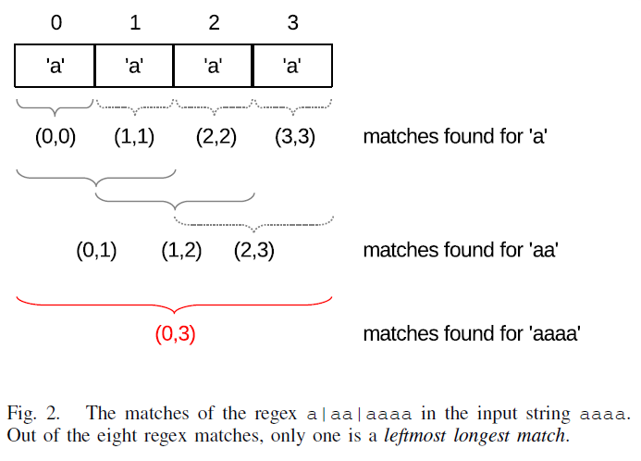
Proposed Scheme
Each regex match is associated with a span (s, e), where s is the start-offset position and e the end-offset position of the regex match.
The leftmost regex match at offset position i is the regex match with the smallest start-offset position value that ends at offset position i.
A leftmost longest regex match is a regex match that is not contained in any other regex match.
Out of these eight matches, only four are leftmost matches.
These are associated with spans (0, 0), (0, 1), (1, 2),and (0, 3).

Slide 5
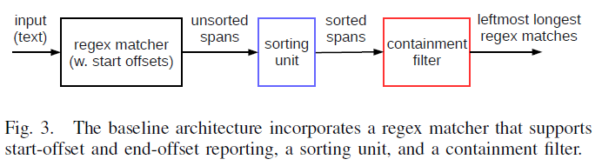
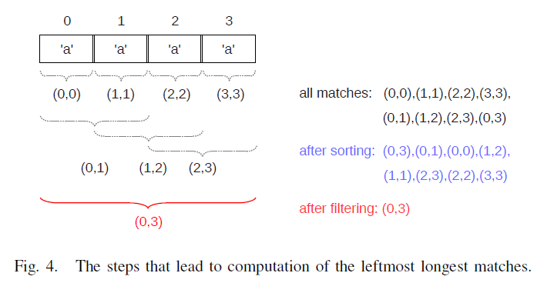
Proposed Scheme
The spans produced by the regex matcher are initially unsorted and can be sorted
in increasing order of the start
offsets, where the spans having
the same start offset are sorted
in decreasing order of their
end offsets.

Slide 6
Proposed Scheme
The containment filter processes the sorted spans in a streaming way, and stores only one span in its local registers.
As an example, assume that spans (0, 1), (2, 3), (2, 4), and (1, 5) are produced
by the regex matcher.
After sorting, the spans are reordered as follows: (0, 1), (1, 5), (2, 4), and (2, 3).
The containment filter stores the first span (0, 1) in its registers. When the second span (1, 5) arrives, (0, 1) is written to output and (1, 5) is written to the registers.
(2, 4) and (2, 3) are not leftmost longest matches and are filtered out because they are contained in (1, 5).
When the end-of-stream signal arrives, (1, 5) is written to the output. As a result, the two leftmost longest matches are computed, namely, (0, 1) and (1, 5).

Slide 7
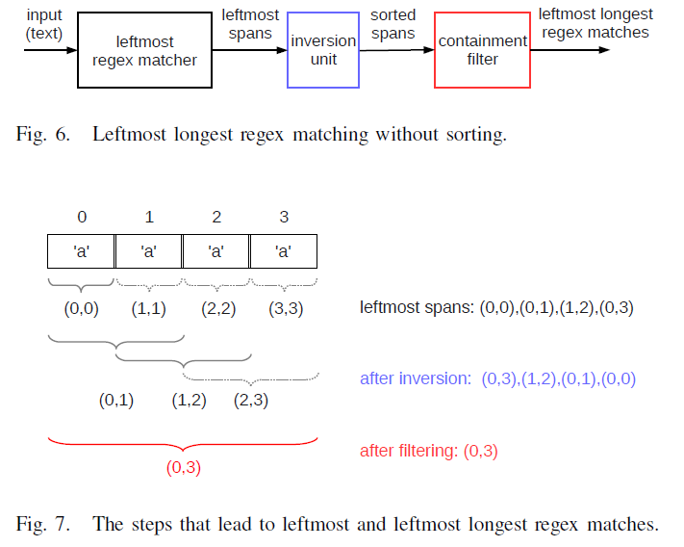
Proposed Scheme
If we simply invert the order of the spans produced by such a leftmost regex matcher, the spans will already be sorted in decreasing order of the end offsets.
There will be no two spans that have the same end offset, but different start offsets.
Therefore, inverting the order of the spans produced by the regex matcher creates a sorted stream of spans that can be consumed directly by a containment filter.

Slide 8
Proposed Scheme
The architectures presented so far can produce leftmost longest regex matches that overlap.
In this section, we therefore present modifications to these architectures that enable computation of non-overlapping leftmost longest matches.
Two spans (s0, e0) and (s1, e1) overlap if (s1 > s0) and (e1 > e0) and (s1 · e0) or if (s0 > s1) and (e0 > e1) and (s0 · e1).
s0 | s1 | … | e0 | e1
s1 | s0 | … | e1 | e0

Slide 9
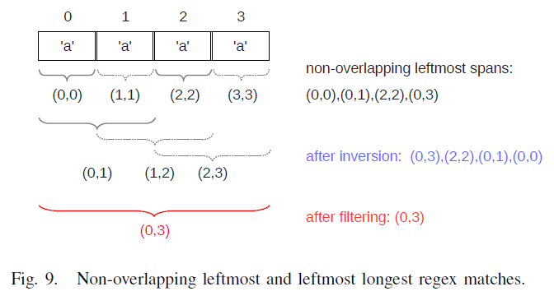
Proposed Scheme
Computing the non-overlapping leftmost longest matches is to produce all possible regex matches, sort the associated spans, and filter out overlapping spans.

Slide 10
Results and Analysis
Our designs were synthesized using the Quartus II 12.1 software, for an Altera Stratix IV GX530 FPGA.
We used the maximum effort settings of the synthesis tool.
The start-offset and the end-offset positions stored in the span data structures
were 32 bits wide in our experiments.
The logic resource consumption of the inversion unit and the containment filter was minimal.
These two units together consumed approx. 100 combinational ALUTs and approx. 90 dedicated registers (bits of storage), and achieved a clock frequency of approx. 300 MHz.

Slide 11
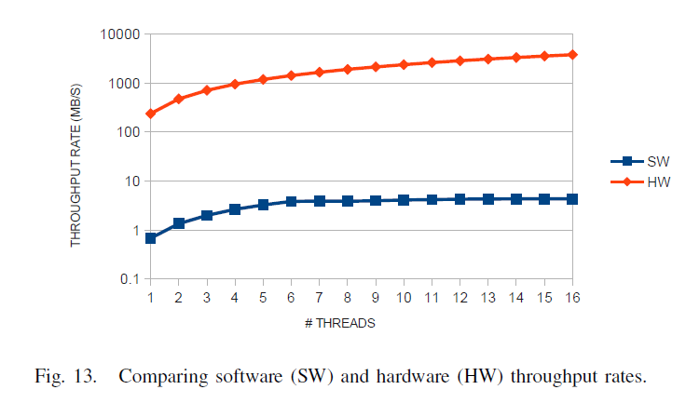
Results and Analysis
Experiments were performed using a regex set with 25 regexs from the text analytics domain.

